Slide 1







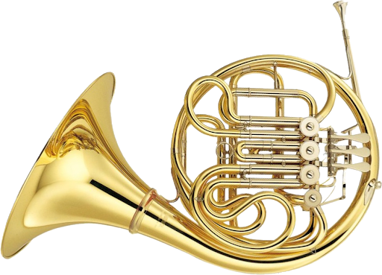


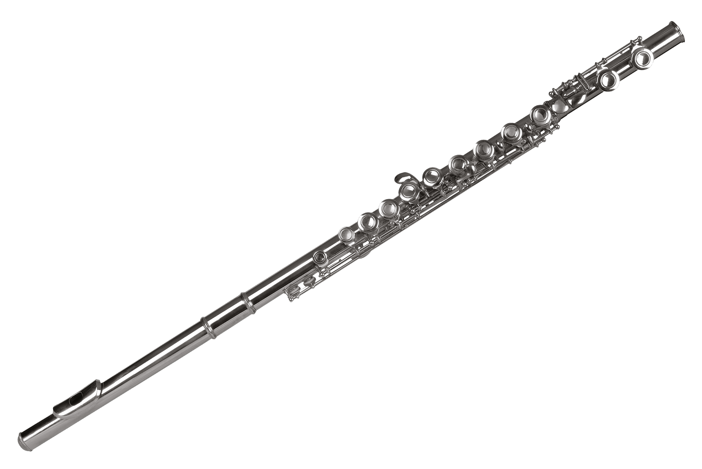
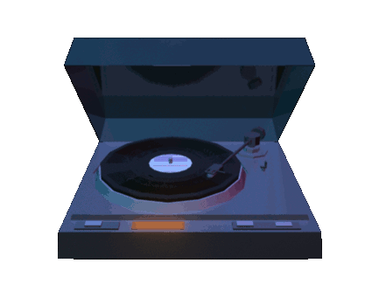

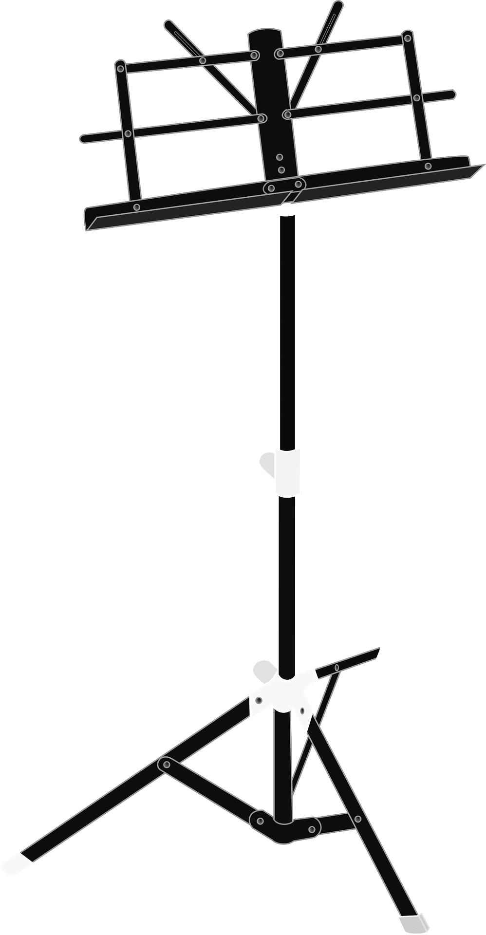


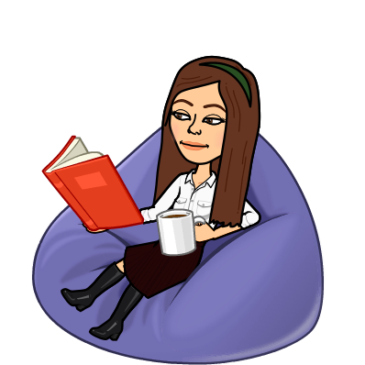


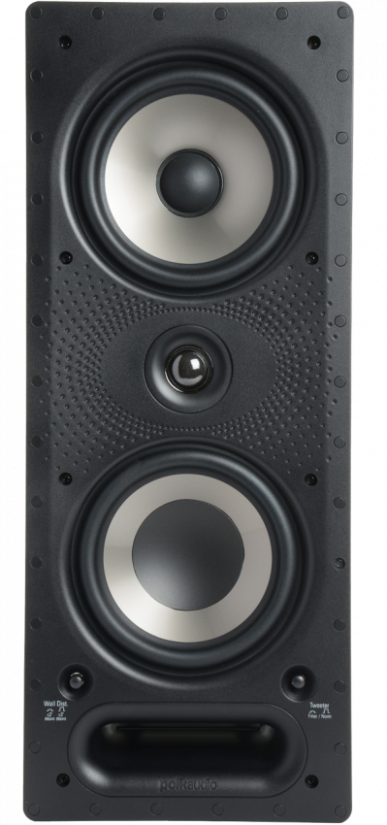

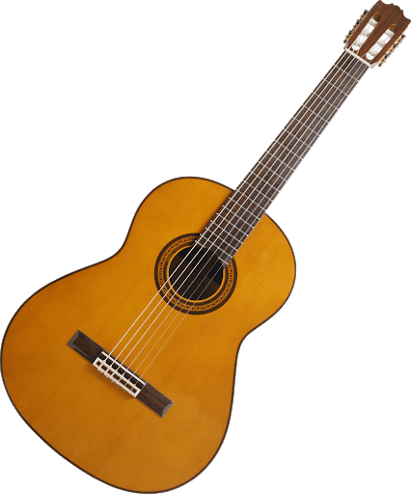


Slide 2
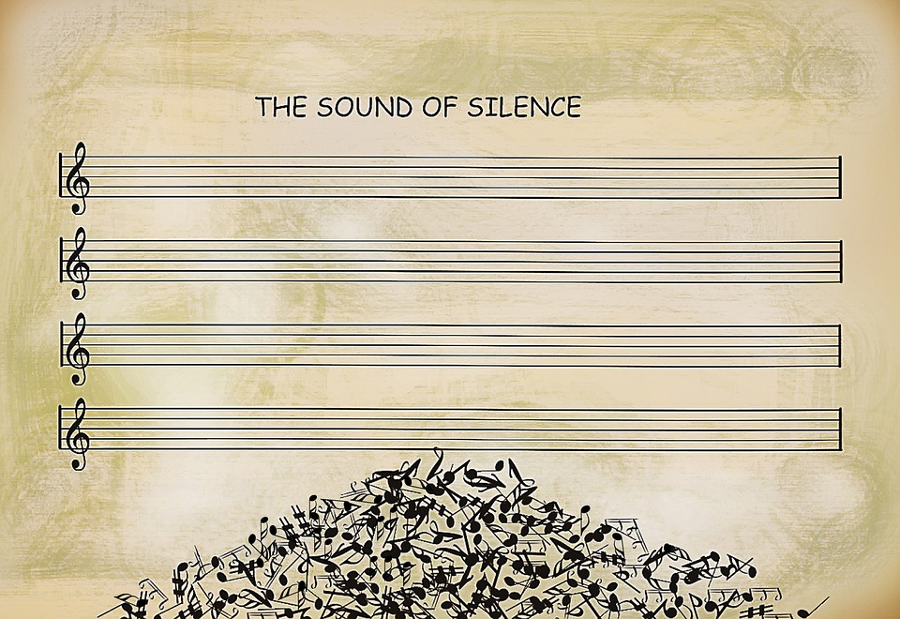
Orchestra
In our elementary school instrumental music program we aim to provide students with the opportunity to broaden and enrich their musical experiences. The course is designed to provide students with skills that will build on their current level of musical achievement. More specifically we work on instrument proficiency and the fundamentals of the students’ chosen instrument. Building confidence within their own skill set we look further into analyzing music. Understanding the structure of music will guide us into the purpose of the music and the composer's musical decisions. Most importantly, have fun learning and enjoying music!
Orchestra is every Friday at 7:20 am in the music room.

